Slide 1
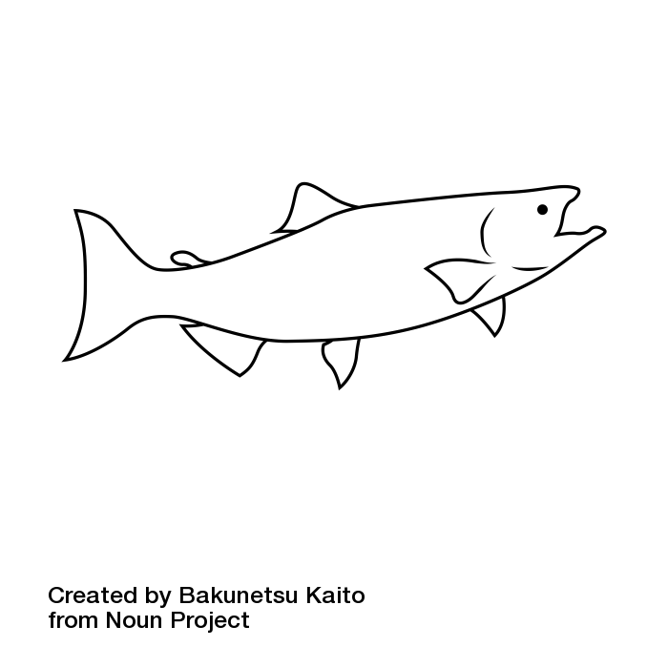
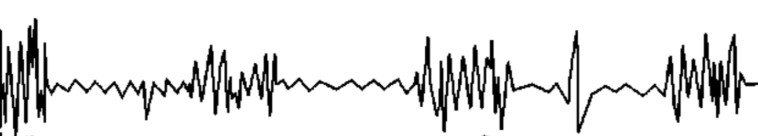

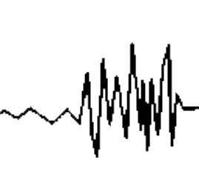
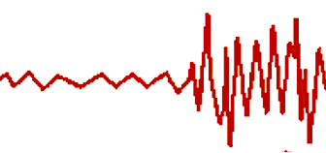
Field observations
Swim tests
U_{crit} / U_{max}
Time to fatigue / endurance
LONG ( h), HIGH METABOLIC COST
SHORT (< h) MEDIUM METABOLIC COST
EMG tag
Recovery
costs
RECOVER WHILE SWIMMING
ANAEROBIC
Muscle
activation
White muscle
Red muscle
AEROBIC
Sustained long timeframes, indefinite
Ellerby and Altringham JEB 2001
BURST
BURST
&
COAST
Speeds above what can be measured in swim flumes & tunnels
Swim speed
STEADY SWIM (FAST)
STEADY SWIM
BURST
PROLONGED
SUSTAINED
< 15 s
min
~ 30 min to 2 h
Hours to days
Timeframe

Slide 2
LONG ( h), HIGH METABOLIC COST
SHORT (< h) MEDIUM METABOLIC COST
Recovery
RECOVER WHILE SWIMMING
ANAEROBIC
Muscle
activation
White muscle
Red muscle
AEROBIC
Field observations
Swim tests
Ucrit / Umax
FATIGUE
Time to fatigue / endurance
Ellerby and Altringham JEB 2001
BURST
BURST
&
COAST
Swim speed
STEADY SWIM (FAST)
STEADY SWIM
SPRINT
PROLONGED
SUSTAINED
< 15 s
min
~ 30 min to 2 h
Hours, days
Timeframe

Slide 3
BURST &
COAST
Time to fatigue / endurance
Ucrit / Umax
Burst
STEADY SWIM
Swim speed
AEROBIC
ANAEROBIC
Muscle
activation
White muscle
Red muscle
SUSTAINED
PROLONGED
BURTS, SPRINT
SUSTAINED
PROLONGED
BURTS, SPRINT
Swim speed
Ellerby and Altringham JEB 2001
Burst
Field observations
Ucrit / Umax
Time to fatigue / endurance
Swim speed
STEADY SWIM
FATIGUE
BURST &
COAST
STEADY SWIM
Few sec
~ 30 min to 2 h
Several hours to definite
Short (sec)
Timeframe
Long (h, days)

Slide 5
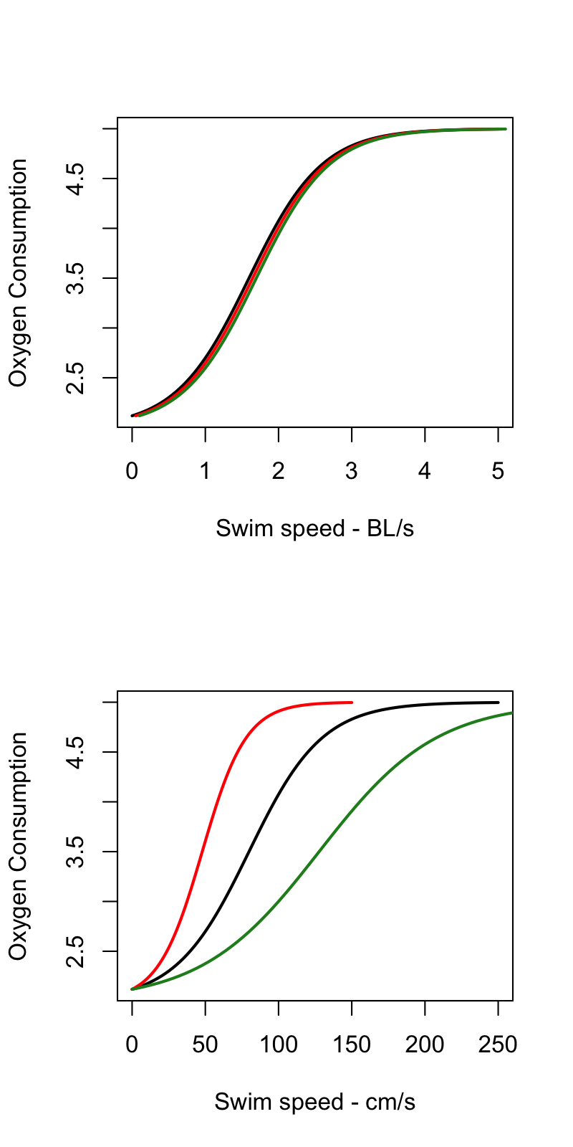

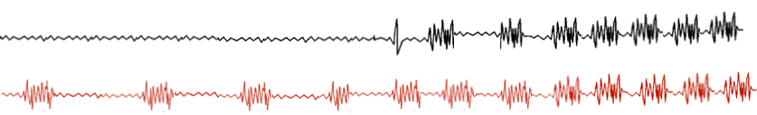
Smaller fish will transition to ANAEROBIC metabolism at lower velocities
BL/s as a unit has limitations but many studies only report BL/s
RELATIVE SWIM SPEED
ABSOLUTE SWIM SPEED
AEROBIC and ANAEROBIC POWER ³
A
Anaerobic
swim speeds
B
C
~ 2 BL/s
~ 2 BL/s
Anaerobic - bursts and sprints
Mass-specific oxygen consumption rate
Mass-specific power requirements
Aerobic swim speeds
Aerobic to anaerobic transition at
~ 80 % Ucrit ^{1,2}
30 cm
ANAEROBIC SCOPE
50 cm
STEADY
BURST & COAST
BURST
80 cm
Aerobic - recovery
Swim speed BL/s
Swim speed cm/s
Body size
Geist et al 2003, Hachim et al 2021
WM
RM
Notes:
We want to emphasize that swimming capacity is a function of fish size.
aerobic swimming and fish size: tested, but not often in adult salmon / more in other species. For example, Tirsgaard et al CBPA 2015 work on Cod
Anaerobic – generally, no true idea about adult salmon (?! right?). They can sprint faster, yes, but what are the consequences, e.g. larger fish can’t recover as well? Especially in warmer water conditions? (e.g. Clark et al PloS ONE 2012)

